Slide 1
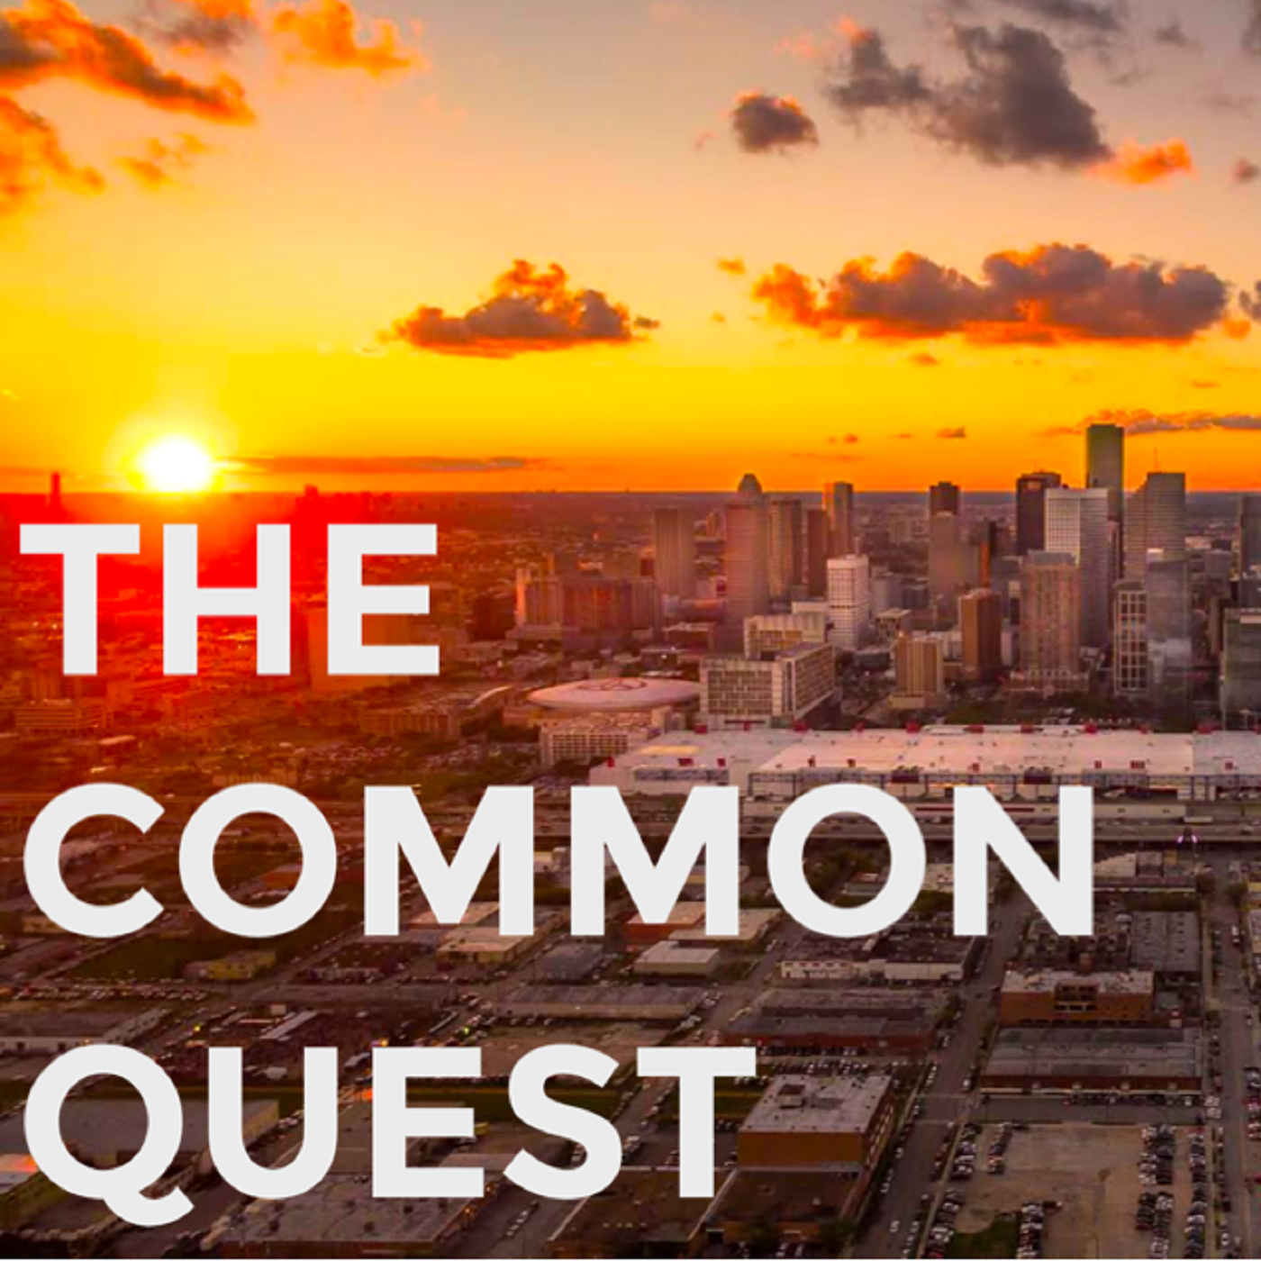
Resources for Entrepreneurs in Houston
Essential Reading
Talking to Humans by Giff Constable
An essential read about talking to your real or potential customers before you start your business. (Thank you to Kelly McCormick and Hesam Panahi for the referral!).
Read | Website
The War of Art by Steven Pressfield
An outstanding work on how to bring to life the “art” within you, be it a new business, a book, a piece of music, or something else important to you.
Read | Listen | Website
Entrepreneurship Organizations
TXRX Labs
Houston’s makerspace. Bring your ideas to life. Hackerspace, rapid prototyping, wood shop, machine shop, creative spaces, coworking. Awesome classes.
Txrxlabs.org
REDLabs
The University of Houston’s startup accelerator, with resources from the Bauer College of Business and Wolff Center for Entrepreneurship. Tech entrepreneurship program. Coworking. Lots of good stuff.
Redlabs.uh.edu
Rice Innovation and Entrepreneurship
The home Rice’s entrepreneurship initiatives, including Rice Alliance, Liu Idea Lab, Rice Business, the Rice Business Plan Competition, and Rice EO.
Entrepreneurship.rice.edu
Station Houston
A vibrant startup community. Coworking. Mentorship. Venture fund. Monthly Demo Day. And lots of excellent events.
Stationhouston.com
TMCx
Part of the Texas Medical Center’s Innovation Institute, TMCx provides coworking, resources, and classes for health care entrepreneurs. TMCx+ incubator. Biodesign one-year innovation fellowship. JLABS@TMC. AT&T Foundry for Connected Health.
Prepared by The Common Quest: Resources for entrepreneurs.
thecommonquest.com

Slide 2
Resources for Entrepreneurs in Houston
Entrepreneurship Organizations (cont’d)
Houston Exponential
New organization to champion Houston’s innovation ecosystem, formed by the Greater Houston Partnership, Mayor Turner’s Innovation and Technology Task Force, and the Houston Technology Center.
houstonexponential.org/
Southwest I-Corps
Hands-on courses and initiatives to help scientists, engineers, and researchers understand the value to society of their discoveries. Imitative by the National Science Foundation supported by UT, Rice, Texas Tech, MD Anderson, Texas A&M.
Swicorps.org
Incubators, Accelerators, Startup Competitions, Hackathons
Monarq Incubator
Powering exceptional women-led startups. Mentorship. Funding. Resources. Community.
monarqincubator.com
Madhatter Coalition
Houston’s first venture studio. Works alongside startup founders from conception to successful company. Understand your X for Y to craft a meaningful brand.
madhattercoalition.com
StartHereNow
Women’s startup weekend. Part incubator, part pitch-day, brainstorming session, and hackathon, we help you Start your business. Here. Now.
Startherenow.org
City of Houston Hackathon
24 hours to help solve civic issues together. A great initiative by Sketch City.
houstonhackathon.com
LiftOff Houston
Annual startup competition and accelerator by the City of Houston’s Office of Business Opportunity (which has a lot of other resources for entrepreneurs).
Website
Prepared by The Common Quest: Resources for entrepreneurs.
thecommonquest.com

Slide 3
Resources for Entrepreneurs in Houston
Meetups
Houston Lean Startup Circle
Inspired by the works of Eric Ries and Steve Blank, the Lean Startup Circle provides monthly seminars on lean startup methodology. Lots of good resources.
Meetup
Sketch City
Active community group that focuses on civic tech, open data, and public-sector innovation. Hosts weekly hack nights and the annual City of Houston Hackathon. Meetup | Website
Communities and Office Space
Headquarters
Vibrant, award-winning office space and startup community in East Downtown, which we proudly call home. Home to several other organizations listed here and, of course, Giant Leap Coffee.
headquartershtx.com
The Cannon
New coworking campus under development on the west side of town.
thecannonhouston.com
WeWork
Houston’s outposts of the global co-working startup. Locations in the Galleria area and downtown. Lots on offer.
Houston locations
Level Office
Love your office. Coworking offices in two locations downtown. Houston locations
Newsletters
Texas-Squared Startup Newsletter
Marc Nathan’s email newsletter on Texas tech/startup events and community. Subscribe at bitly.com/texassquared or view online
Resources for Freelancers
DoubleYourFreelancing
Excellent podcast, conferences, and courses for freelancers by Brennan Dunn. Popular courses such as Double Your Freelancing Rate.
doubleyourfreelancing.com
Prepared by The Common Quest: Resources for entrepreneurs.
thecommonquest.com

Slide 4
Resources for Entrepreneurs in Houston
Resources for Health & Fitness Entrepreneurs
Barbell Business
Excellent podcast and software for gym owners, trainers, and anyone in the strength and conditioning industry. Companion to Barbell Shrugged.
Website
Digital Media and Software Development
Hassan Noueilaty and Nydia Segura-Reyna
Software developers: building functional and practical software to solve business needs.
Hasan Noueilaty | Nydia Segura-Reyna
Digital Crafts
An immersive, full-stack web development boot camp at Headquarters. Entrepreneurs can apply for students to work on sponsored projects.
digitalcrafts.com
La Praim
App development, web design, digital marketing, virtual reality. Headquarters.
lapraim.com
Timbergrove
Software development and consulting firm at Headquarters. Advanced analytics and internet of things.
timbergrove.com
Tangelo
Idea driven branding and advertising firm. Headquarters.
Tangelo.studio
DECODE
Award-winning digital agency in Houston
decodedigital.co
Zebra Marketing Solutions
Marketing automation, lead generation, online advertising. Zebra hosts a weekly Facebook Live seminar.
Website
Prepared by The Common Quest: Resources for entrepreneurs.
thecommonquest.com

Slide 5
Resources for Entrepreneurs in Houston
Funding: Small Business Administration Loan Program
Anita Leung: VP, Frost Bank
Frost Bank’s Small Business Administration Loan Program. Knowledgeable resource for anyone looking to apply to the various SBA loan programs.
Contact
Resources for Non-Profits
Baker Ripley
BakerRipley builds vibrant communities to keep Houston a place of opportunity for all who are working for a better life.
Bakerripley.org
Podcasts / Online Resources
BizLatte
Houston-based blog, resources, training to help you find your professional purpose.
BizLatte.com
MindfulBusiness
Creating Social Capital: Doing Business with a Mindset of Abundance
MindfulBusiness
The Common Quest
Interviews with entrepreneurs in Houston. Available on on Apple Podcasts, Google Play and Stitcher.
thecommonquest.com
Prepared by The Common Quest: Resources for entrepreneurs.
thecommonquest.com

